Slide 1
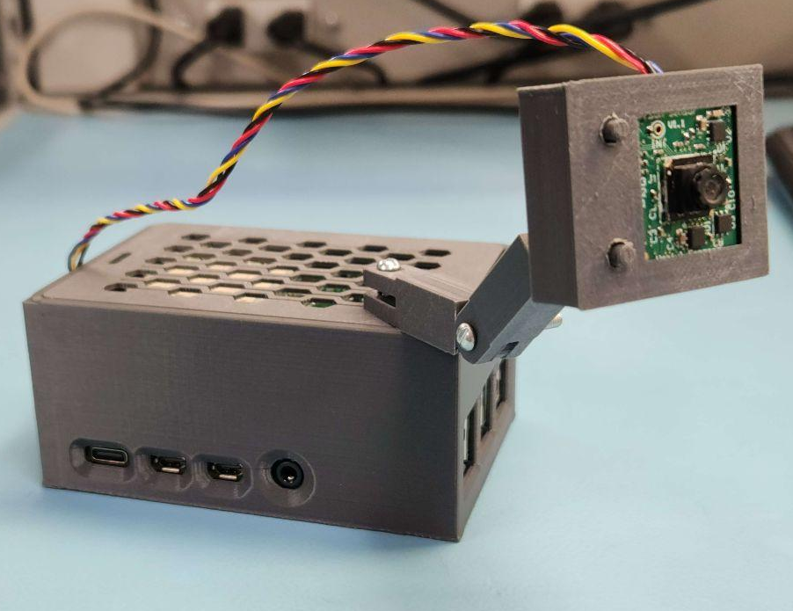
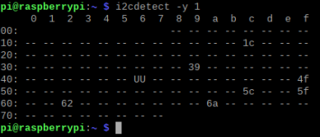
Person Sensor by Useful Sensors
Aaron Morris Basco Jara
I2C address: 0x62

Slide 2
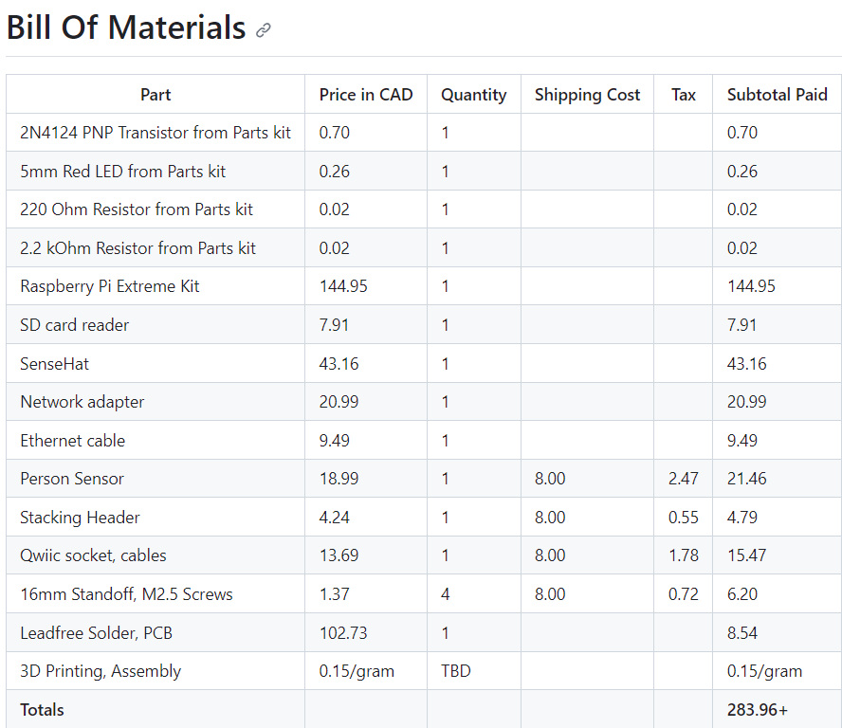

Slide 3
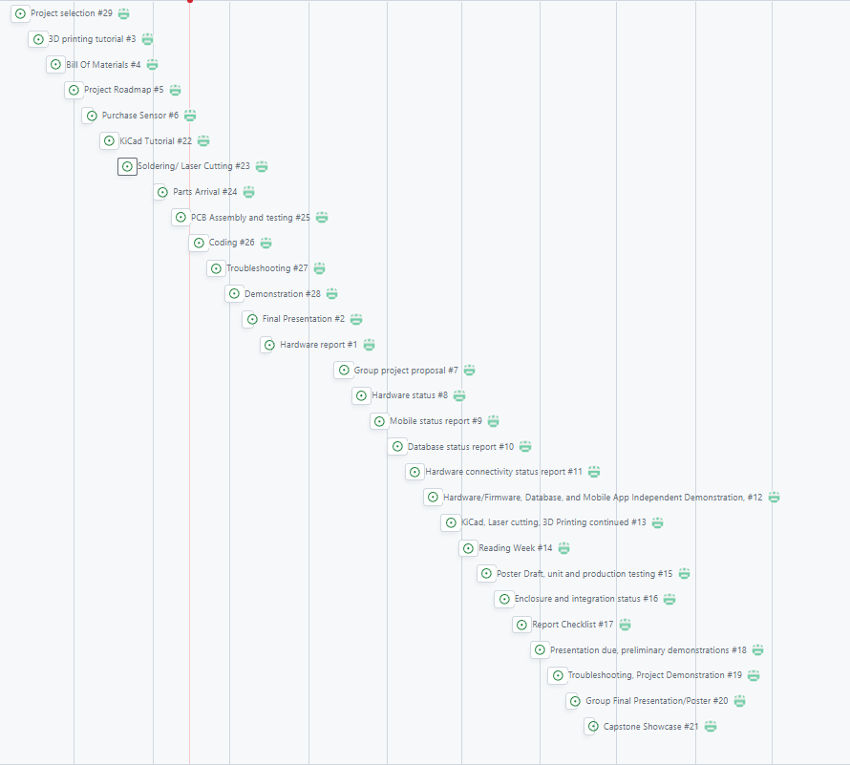

Slide 4
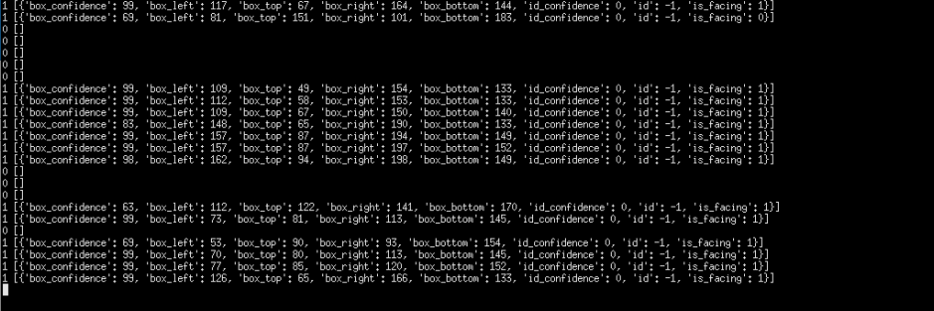
Reading/Writing to Sensor/Effector

Slide 5
Course Knowledge
How to use a multimeter (Tech101 - Electric Circuits)
How to read a resistor (Tech101 - Electric Circuits)
The basics of creating a circuit to light up a led (Tech101 - Electric Circuits)
How to test if a circuit is shorted (Tech101 - Electric Circuits)
Connect to the Pi from VNC viewer (Ceng153 – Programming in C)
Use WinScp to move files to the Pi (Ceng153 – Programming in C)
- The basics of programming (Tech104 – Programming Fundamentals)

